Slide 1

Seating Arrangement

Slide 2
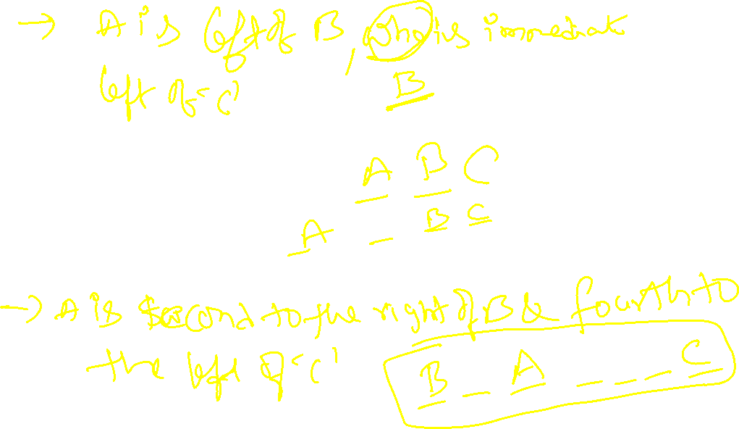

Slide 3
People in a straight line
Linear Seating
Circular Seating
People around a table facing inward or outward
Complex
Arrangements
Involve multiple conditions and categories

Slide 4
Questions on seating arrangement are generally asked in blocks of 4 – 5 questions. You are given some information and then there will 4 -5 questions base on the information. These questions have two types of information: 1. Direct information 2. Indirect information
There are two types of arrangements in Seating Arrangement
1. Linear Arrangement
Let us take the case of linear arrangements. Here if it is stated that there are five persons sitting facing North then the arrangement will be like

Slide 5
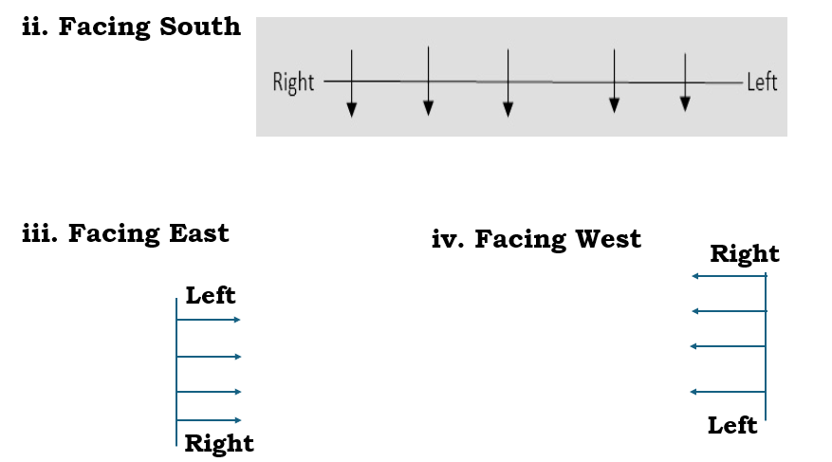

Slide 6
Circular arrangement is of two types
Facing the centre of the circle
If they are looking towards the centre, then the right-hand side will be in the anticlockwise direction and left-hand side will be in the clockwise direction as shown below:

Slide 7
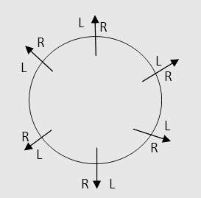
Circular arrangement is of two types
2. Facing away from the center.
If the persons are looking away from the center, then the right-hand side will be in the clockwise direction and left-hand side will be in the anti-clockwise direction as shown below:

Slide 8
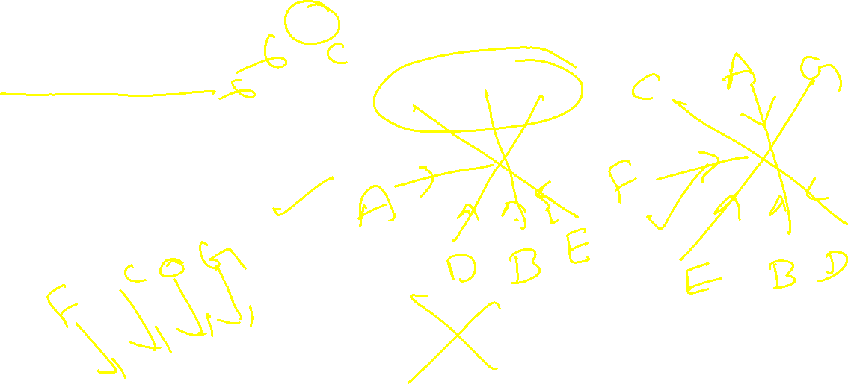
1. A, B, C, D, E, F and G are sitting around a circle and are facing the center.
i. G is second to the left of C, who is to the immediate left of F.
ii. A is third to the left of E.
iii. B is between D and E.
1. Which of the following is false?
a) A is fourth to the right of E.
b) G is to the immediate right of D.
c) F is third to the right of D.
d) B is to the immediate left of D.
e) None of these

Slide 9
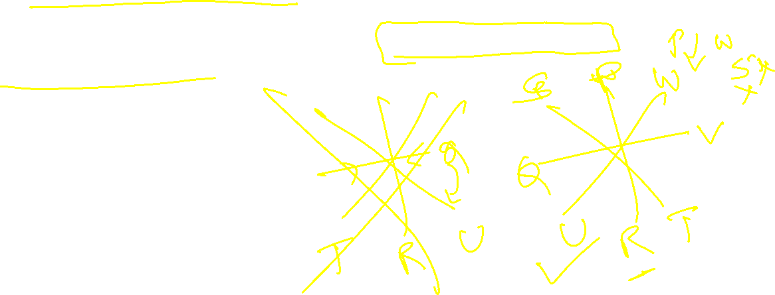
2. P, Q, R, S, T, U, V and W are eight friends sitting around a circle facing towards the centre.
i. W is on the immediate left of P but is not the neighbour of T or S.
ii. U is on the immediate right of Q and V is the neighbour of T.
iii. R is between T and U.
1. What is the position of S?
a) On the immediate left of Q.
b) Second to the right of U.
c) Between Q and U.
d) On the immediate left of P.
e) None of these

Slide 10
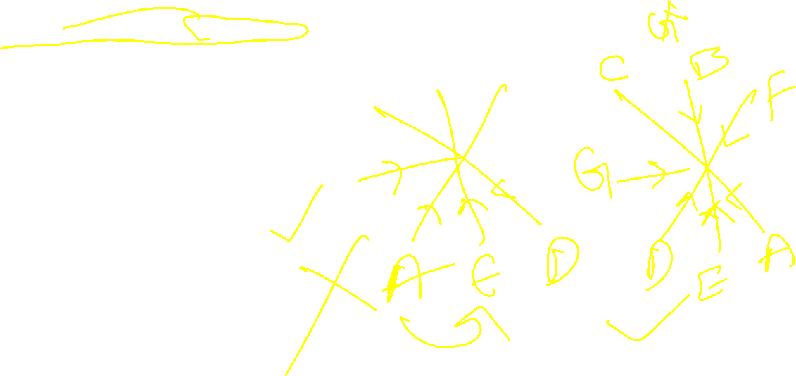
3. A, B, C, D, E, F and G are sitting in a circle facing at the centre and playing cards.
i. E is neighbour of A and D.
ii. G is not between F and C.
iii. F is to the immediate right of A
1. What is the position of F?
a) Third to the left of C
b) Second to the right of C
c) To the immediate left of A
d) To the immediate left of B
e) None of these

Slide 11
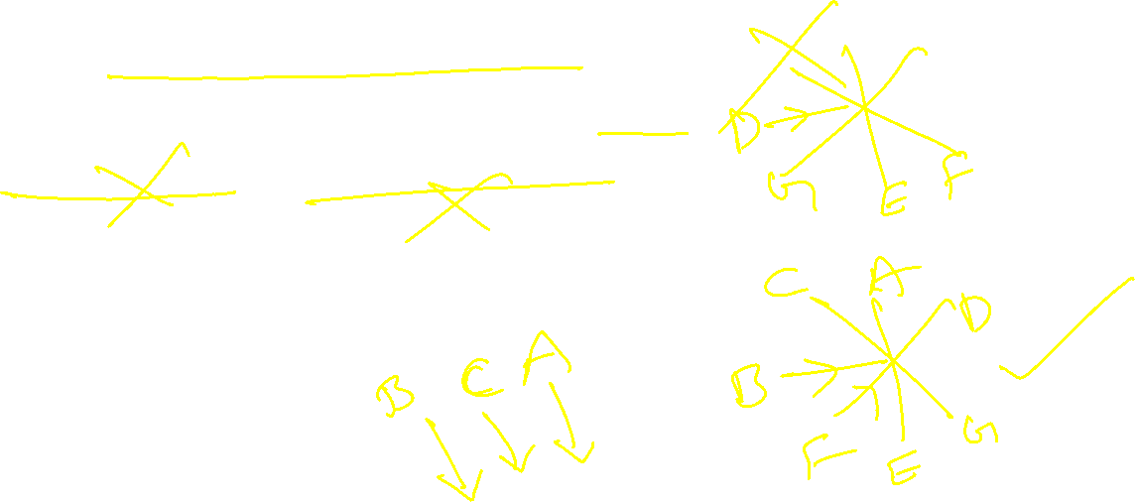
4. Seven people A, B, C, D, E, F, and G are sitting around a circular table facing the center. A sits second to the left of B. C sits immediately to the right of A. E sits between G and F. G sits immediate left of D.
I. Who is sitting fourth to the right of B.
II. How many are there in between A & E From left of A.

Slide 12
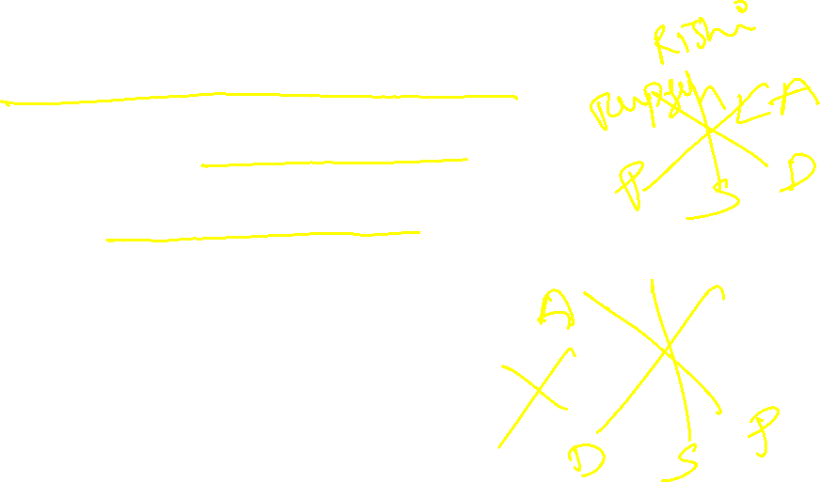
5. Six friends (Rupesh, Preeti, Ashwini, Sachin, Divya, Rishi) are sitting in a circle facing inwards.
i. Preeti and Ashwini are exactly opposite to each other.
ii. Sachin is in between Preeti and Divya.
iii. Divya is immediately to the left of Ashwini.
iv. Rishi is not exactly opposite to Divya.
1. Who are the neighbors of Divya?
a. Rishi and Rupesh
b. Ashwini and Sachin
c. Preeti and Sachin
d. None of these
2. Who is sitting opposite to Divya?
a. Rupesh b. Ashwini c. Sachin d. Rishi

Slide 13
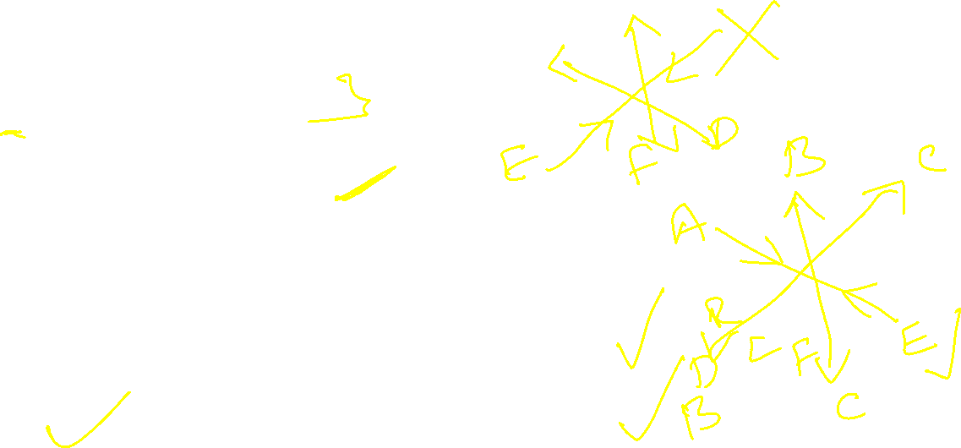
6. Six Friends A, B, C, D, E and F are sitting on a circular table 2 facing inwards and are exactly opposite to each other and rest facing outwards.
i. B is facing outwards and is left to C.
ii. F is in between E and D.
iii. E is facing inwards.
iv. A is 2nd to the left of C.
v. C is not facing inwards.
1. 2 persons exactly opposite to each other and facing center are:
A. B and F B. B and C C. A and E D. E and B
2. If positions of B and D and F and C are interchanged, then who is 2 places left to B?
A. C B. E C. A D. D

Slide 14
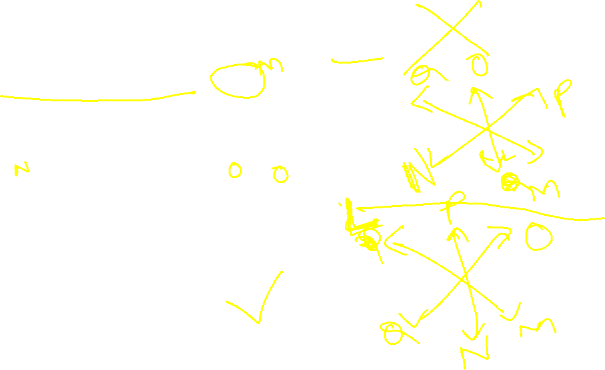
7. Six friends L, M, N, O, P and Q are sitting around a circular table and facing outside. Q is sitting fourth to the left of M, who is sitting to the immediate left of N. P is sitting opposite to N and adjacent to O. O is not sitting adjacent to Q.
Which of the following statements is TRUE?
A. L is adjacent to P
B. M is between O and P
C. P is sitting opposite to Q
D. There are 3 friends sitting between M and L

Slide 15
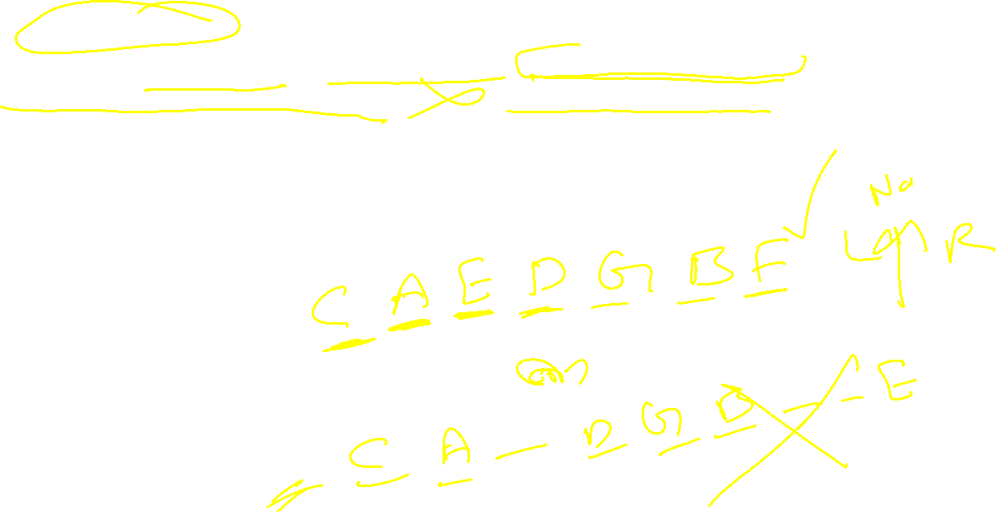
8. Seven children A, B, C, D, E, F and G are standing in a line. G is to the right of D and to the left of B. A is on the right of C. A and D have one child between them. E and B have two children between them. D and F have two children between them.
1. Who is on the extreme right?
a) B b) E c) F d) G
2. Who is exactly in the middle?
a) A b) C c) D d) E
3. Who is extreme left?
a) A b) B c) C d) D

Slide 16
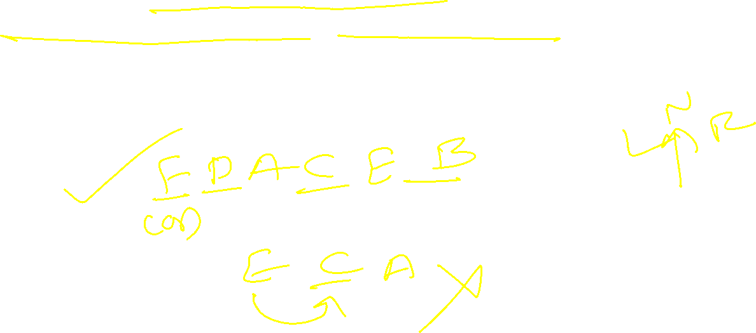
9. Six friends A, B, C, D, E and F are sitting in a row facing towards north. C is sitting between A and E. D is not at the end. B is sitting immediate right of E. F is not at the right end.
How many persons are there to the right of D?
a) One b) Two c) Three d) Four e) None

Slide 17
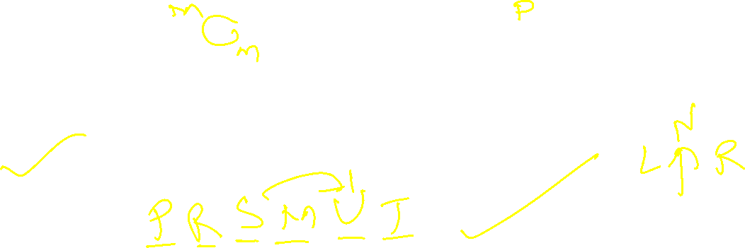
10. Read the following instructions carefully to answer the questions given below
There are six people: P, R, S, M, U, and T seating in a line facing North but not necessarily in the same way. T sits second to the right of M who sits third to the right of P. P sits second to the left of S and to the immediate left of R who sits third to the left of U. Who sits second to the right of S?
a) U b) P c) R d) M

Slide 18
11. Study the following information carefully and answer the questions given below.
Eight persons - P, Q, R, S, T, U, V, and W are sitting in a linear row facing towards the north, but not necessarily in the same order. R sits at the left end of the row. Both T and Q are immediate neighbors of U. Either T or Q sits at one of the ends of the row. Only one person sits between S and W, who sits second to the left of U. As many persons sit between W and Q is same as between P and R. P sits to the right of V.

Slide 19
11. 1. What is the position of S with respect to Q?
a. Third to the left b. Fifth to the left
c. Second to the left d. Immediate right
2. Who among the following person sits second to the right of V?
a. S b. Q c. W d. P
3. If V and T interchange their position, then who among the following person sits third to the right of S?
a. P b. Q c. T d. V
4. How many persons sit between S and U?
a. 1 b. 4 c. 3 d. 2
5. Which of the following statement(s) is/are not true with respect to the final arrangement?
a. No one sits to the left of R b. Only two persons sits b/w W and Q
c. W sits exactly between P and T d. U sits immediate right of Q

Slide 20
12. Study the following information carefully and answer the below questions
Eight persons- L, M, N, O, P, Q, R, and S are sitting at the circular table facing outside but not necessarily in the same order. P sits second to the right of R. Two persons are sitting between S and Q. Q sits adjacent to R. M sits third to the right of L. M and P are not immediate neighbours. L sits second to the left of O. The number of persons sitting between N and M is the same as between N and S.
Who among the following person sits second to the right of Q?
A. The one who sits second to the left of S
B. O
C. The one who sits immediate left of M
D. N

Slide 21
13. Read the following information to answer the given questions:
(A) A, B, C, D, E, F and G are playing cards sitting around a circular table.
(B) D is not neighbour of C or E.
(C) A is neighbour of B and C.
(D) G, who is second to the left of D, is the neighbour of E and F.
1. Which of the following is correct?
1) B is between A and D
2) D is between F and G
3) E is to the immediate right of G
4) F is to the immediate left of G 5) None
2. Which of the following has the pair with the second person sitting to the immediate right of the first person?
1) BD 2) GF 3) EC 4) AE 5) None

Slide 22
14. In Row – 1 P, Q, R and S are seated (but not necessarily in the same order) and all of them facing South.
In Row – 2 A, B, C and D are seated (but not necessarily in the same order) and all of them facing North.
There fore in the given seating arrangement each member seating in the row faces another member of the other row. R sits second to the right of P. A is an immediate neighbor of the person who faces R. Q sits second to left of the person who faces A. Only one person sits between B and C. C does not face P. C does not sit any extreme ends of the line.
1. Four of the five are alike in a certain way based on the given seating arrangement and thus form a group. Which is the one that does not belong to that group?
(1) A (2) P (3) R (4) B (5) S

Slide 23
15. A group of three boys A, E, F and three girls B, C, D are made to sit in a row for a meeting, but they have some conditions as stated below:
i. A will occupy a seat at an extreme end.
ii. B will sit at an extreme position and adjacent to C, who will not sit beside another girl.
iii. F will sit by the side of A, but not adjacent to E.
Question:
Who will occupy the fourth seat starting from A?
Options:
(A) D (B) E (C) C (D) F

Slide 24
16. Seven persons A, B, C, D, E, F, and G are standing in a row such that all of them are facing towards the north, positioned from left to right. The following conditions are given:
i. There are four persons between A and G.
ii. There are two persons between E and D, where E is to the left of D.
iii. B and C are not together.
iv. D is to the immediate right of G.
v. B is to the immediate right of E.
If B is to the immediate right of E, then who is at position 2?
(A) C (B) F (C) Cannot be determined (D) E

